Slide 1
Introduction to machine learning
Python
Wrocław, 2022

Slide 2
Artificial Intelligence
Machine Learning
Reasoning
Natural Language Processing
Planning

Slide 3
Artificial Intelligence
Machine Learning
Supervised learning
Unsupervised learning
Reinforcment learning
Deep learning

Slide 4
Supervised learning
Supervised learning algorithms try to model relationships and dependencies between the target prediction output and the input features such that we can predict the output values for new data based on those relationships which it learned from the previous data sets.

Slide 5


Slide 6
CAT
DOG

Slide 7
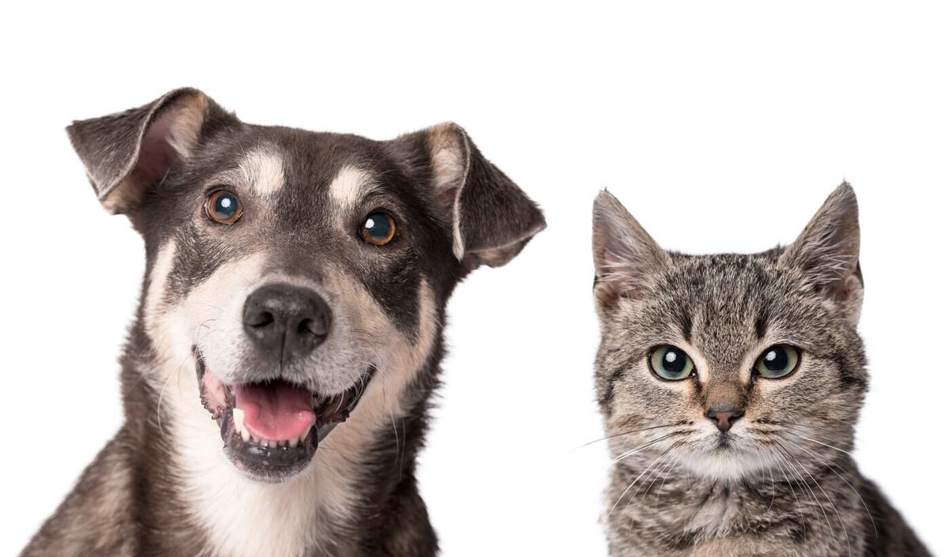


Slide 8
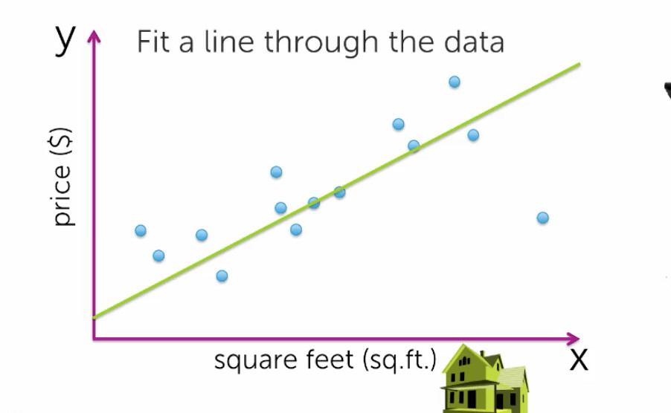

Slide 9
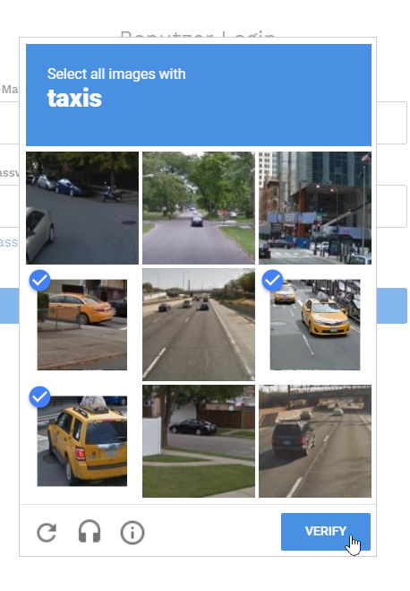
Supervised learning
Supervised learning algorithms try to model relationships and dependencies between the target prediction output and the input features such that we can predict the output values for new data based on those relationships which it learned from the previous data sets.
predictions
data is labeled
regression or classification

Slide 10
Supervised learning
Supervised learning algorithms try to model relationships and dependencies between the target prediction output and the input features such that we can predict the output values for new data based on those relationships which it learned from the previous data sets.
Neareast neigbourgh (NN)
Naive Bayes (NB)
Decision Tree
Linear regression
Support Vector Machines (SVM)
Neural Network

Slide 11
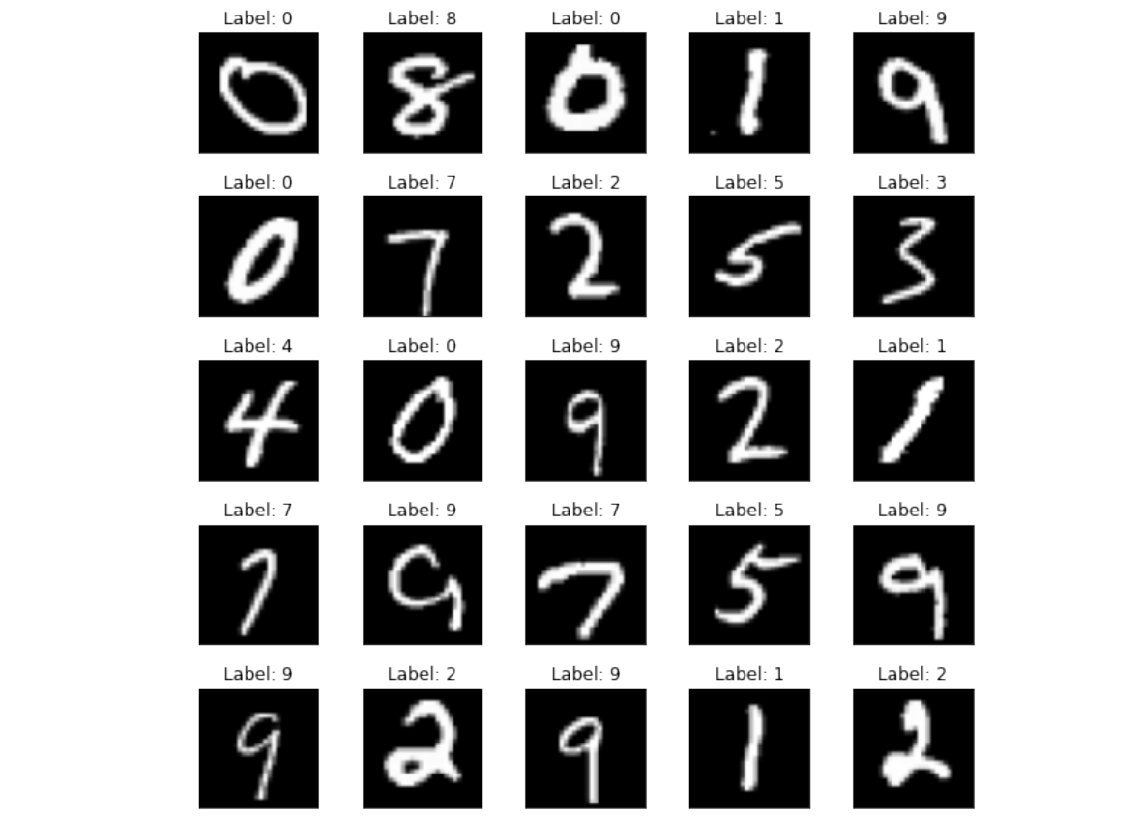
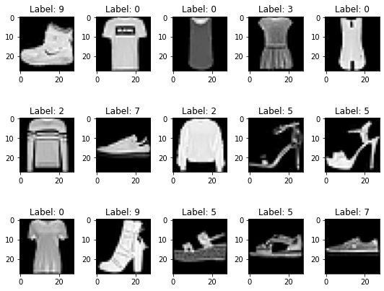
Supervised learning

Slide 12
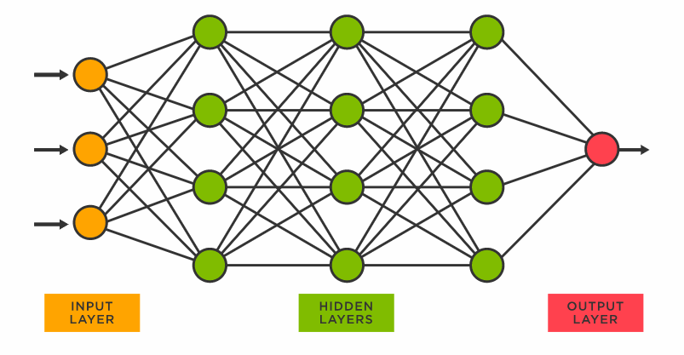
Neural Networks

Slide 13
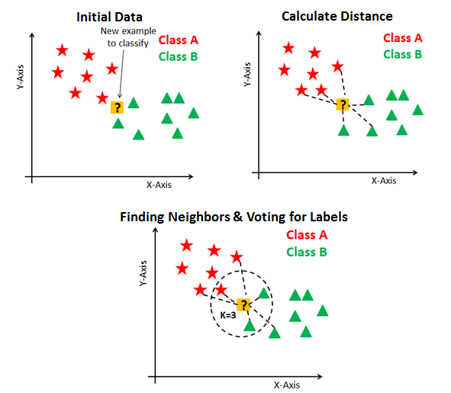
K – Nearest Neighbours

Slide 14
Unsupervised learning
Unsupervised learning algorithms try to use techniques on the input data to mine for rules, detect patterns, and summarize and group the data points which help in deriving meaningful insights and describe the data better to the users.

Slide 15
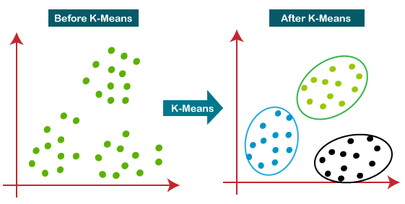

Slide 17
Unsupervised learning
Unsupervised learning algorithms try to use techniques on the input data to mine for rules, detect patterns, and summarize and group the data points which help in deriving meaningful insights and describe the data better to the users.
Descriptions / anomaly detection
data is not labeled
Clustering or association rules

Slide 18
Semi-supervised learning
Part of data is labeled
Reinforcment learning
Data is collected

Slide 19
https://www.youtube.com/watch?v=n2gE7n11h1Y&ab_channel=JieTan

Slide 20
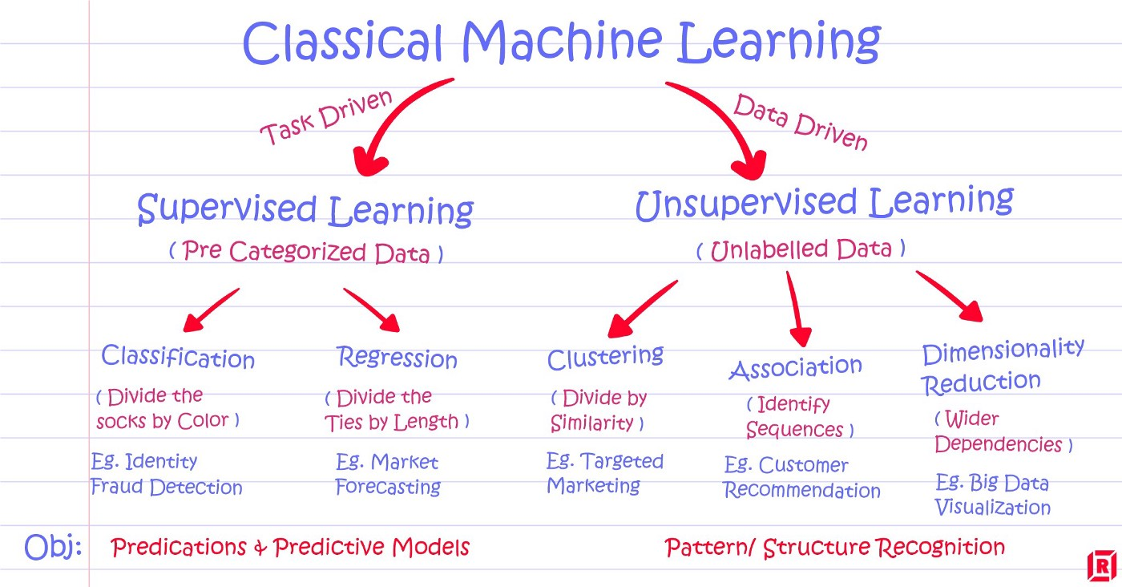

Slide 21
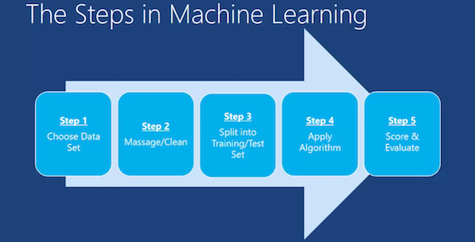

Slide 22
Basic vocabulary
Dataset
Data types
Mean
Median
Mode
Standard deviation
Variance
Distrbution
Training/Test set

Slide 23
Exemplary applications
Traffic Alerts
Social Media
Transportation and Commuting
Products Recommendations
Virtual Personal Assistants
Self Driving Cars
Dynamic Pricing
Google Translate
Online Video Streaming
Fraud Detection
https://www.edureka.co/blog/machine-learning-applications/

Slide 24
Linear Regression
Python
Wrocław, 2022

Slide 25
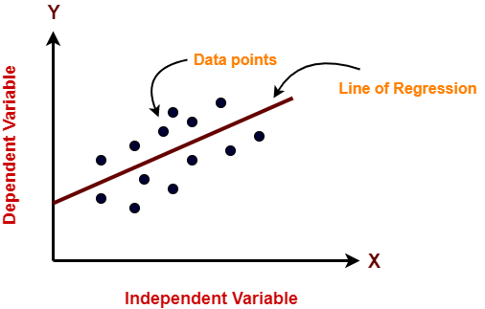
https://www.gatevidyalay.com/linear-regression-machine-learning-examples/

Slide 26
Linear regression in machine learning
supervised learning
simple to use and understand
well-known pros and cons
model finds the best fit linear line between the independent and dependent variable

Slide 27
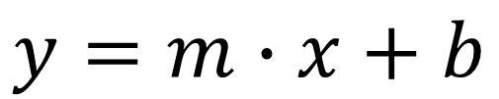
Simple regression
slope
intercept
$$y=m∙x+b$$

Slide 28

Overfitting

Slide 29
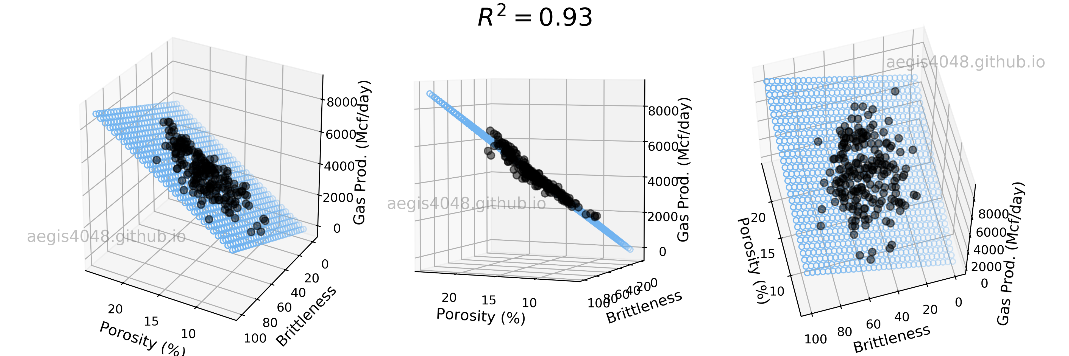
Multilinear regression
$$y=m_{1}∙x_{1}+m_{2}∙x_{2}+ …+m_{n}∙x_{n}+b$$

Slide 30
Simple regression
slope
intercept
$$y=m∙x+b$$
sometimes it can be assumed as 0

Slide 31
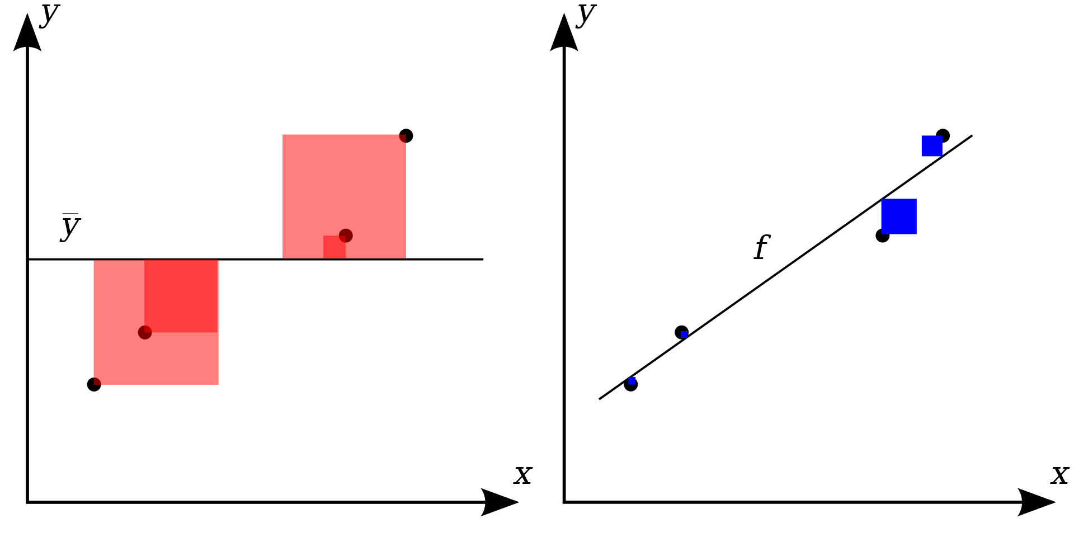
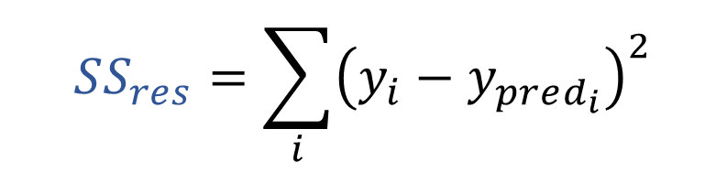
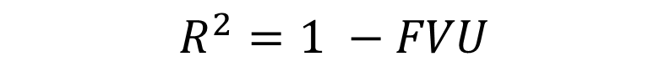
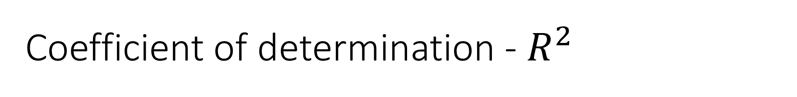
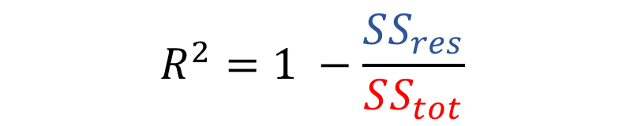
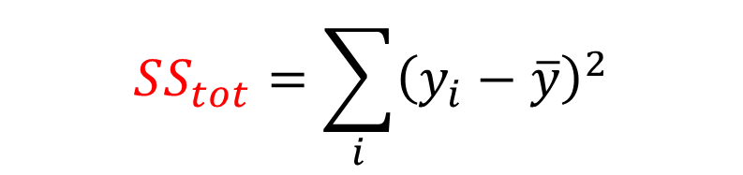
Coefficient of determination - $R^{2}$
$$SS_{res}=\sum_{i}{{\left(y_{i}−y_{pred_{i}}\right)}^{2}}$$
$$SS_{tot}=\sum_{i}{{\left(y_{i}−\overline{y}\right)}^{2}}$$
$$R^{2}=1 −\frac{SS_{res}}{SS_{tot}}$$
unexplained variation
$$R^{2}=1 −FVU$$

Slide 32
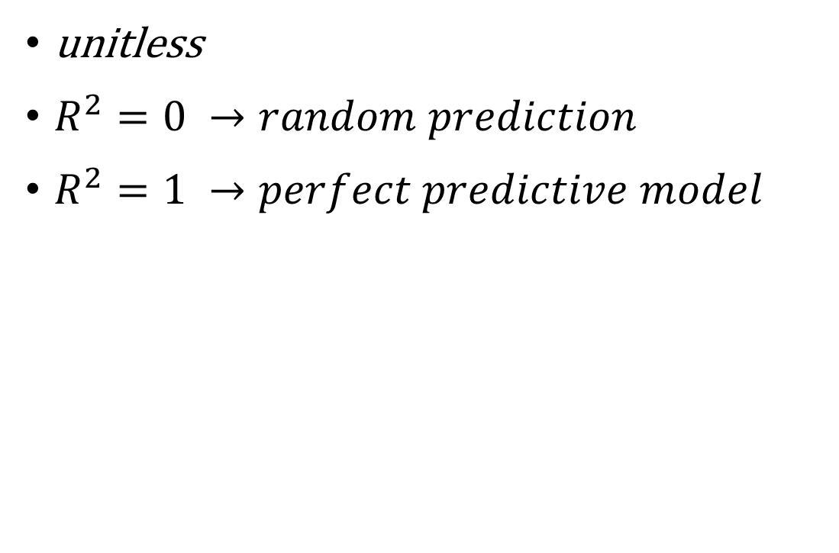
Coefficient of determination - $R^{2}$
unitless
$R^{2}=0 →random prediction$
$R^{2}=1 →perfect predictive model$
https://ocw.mit.edu/courses/sloan-school-of-management/15-071-the-analytics-edge-spring-2017/linear-regression/the-statistical-sommelier-an-introduction-to-linear-regression/quick-question-54/

Slide 33
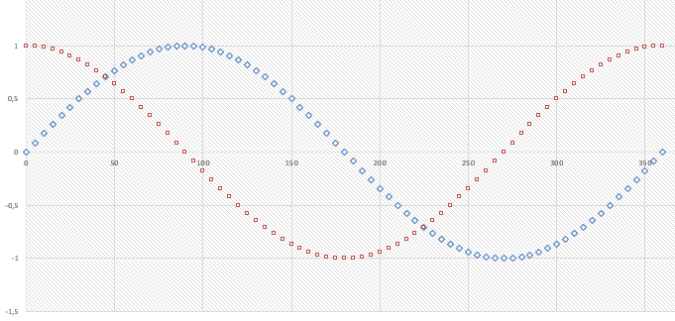
Conditions for linear regression
Relationship between indenpendent and dependent variable should be linear
Data is not noisy
Gaussian distribution of input and output data is better
Rescaling input (standarization or normalization)

Slide 34
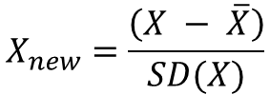
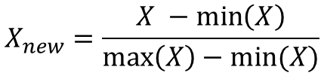
normalization vs standarization
$$X_{new}=\frac{X −\min\left(X\right)}{\max\left(X\right)−min⁡(X)}$$
$$X_{new}=\frac{\left(X − \overline{X}\right)}{SD(X)}$$
Minimum and maximum value of features are used for scaling | Mean and standard deviation is used for scaling.
It is used when features are of different scales. | It is used when we want to ensure zero mean and unit standard deviation.
Scales values between [0, 1] or [-1, 1]. | It is not bounded to a certain range.
It is really affected by outliers. | It is much less affected by outliers.
Scikit-Learn provides a transformer called MinMaxScaler for Normalization. | Scikit-Learn provides a transformer called StandardScaler for standardization.
This transformation squishes the n-dimensional data into an n-dimensional unit hypercube. | It translates the data to the mean vector of original data to the origin and squishes or expands.
It is useful when we don’t know about the distribution | It is useful when the feature distribution is Normal or Gaussian.
It is a often called as Scaling Normalization | It is a often called as Z-Score Normalization.

Slide 35
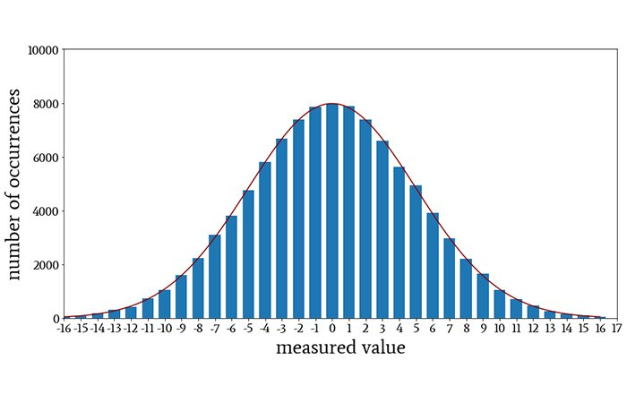
Gaussian distribution

Slide 36
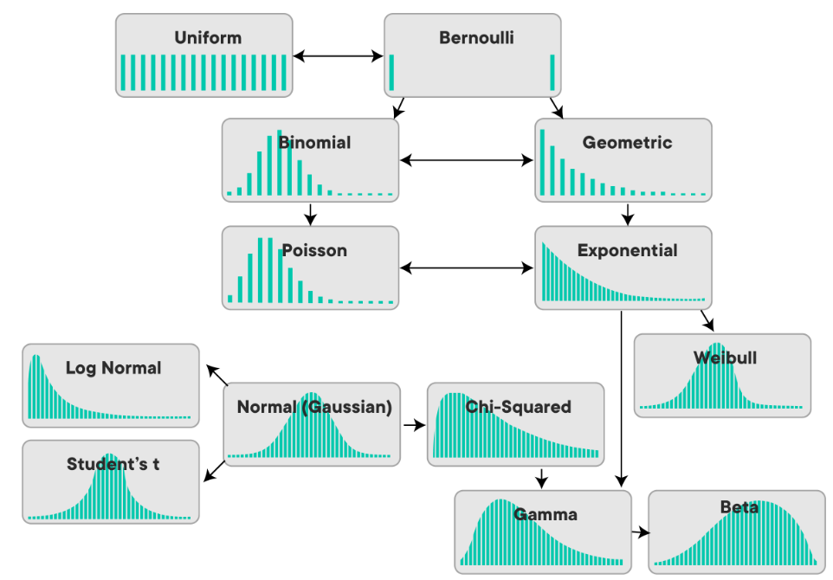
Kinds of distribution

Slide 37
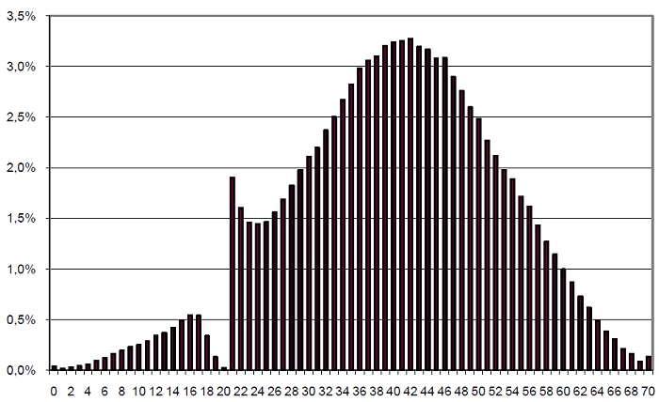
Distribution ?

Slide 38
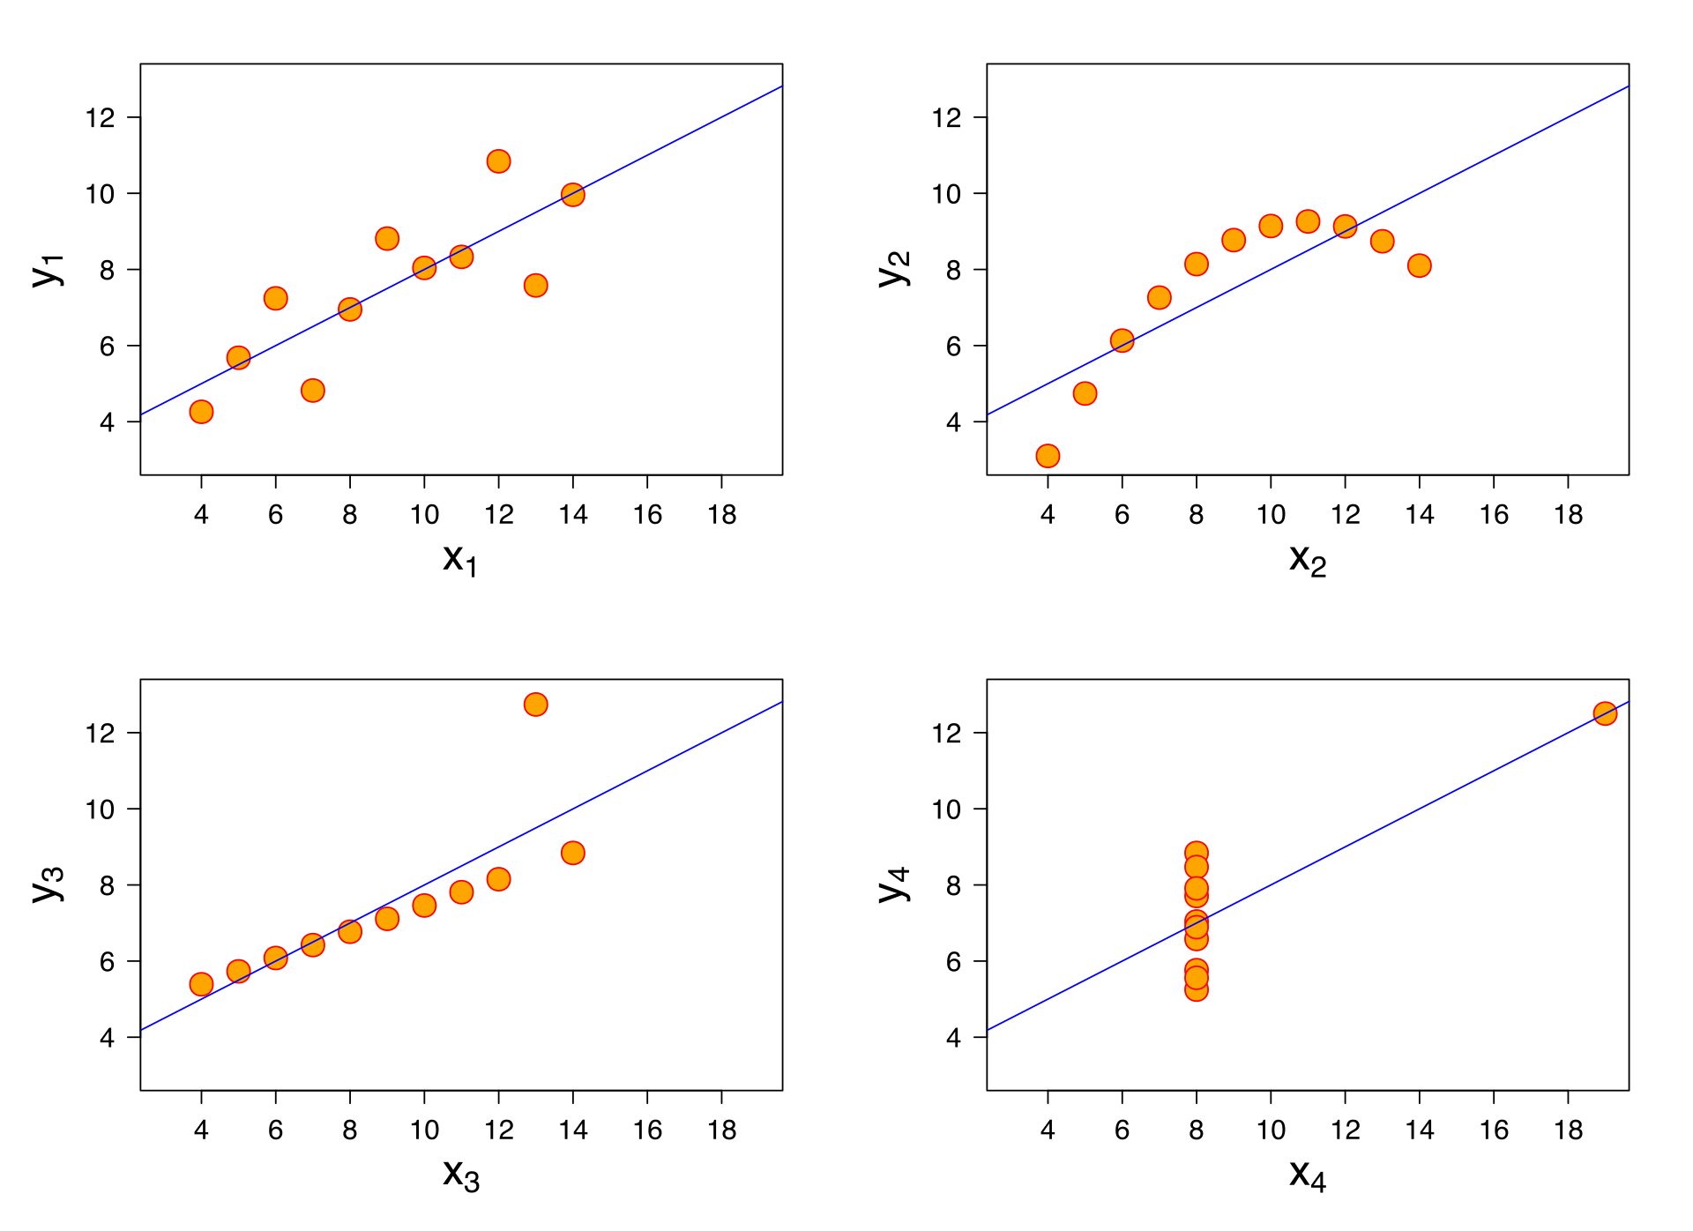
Traps of linear regression

Slide 39
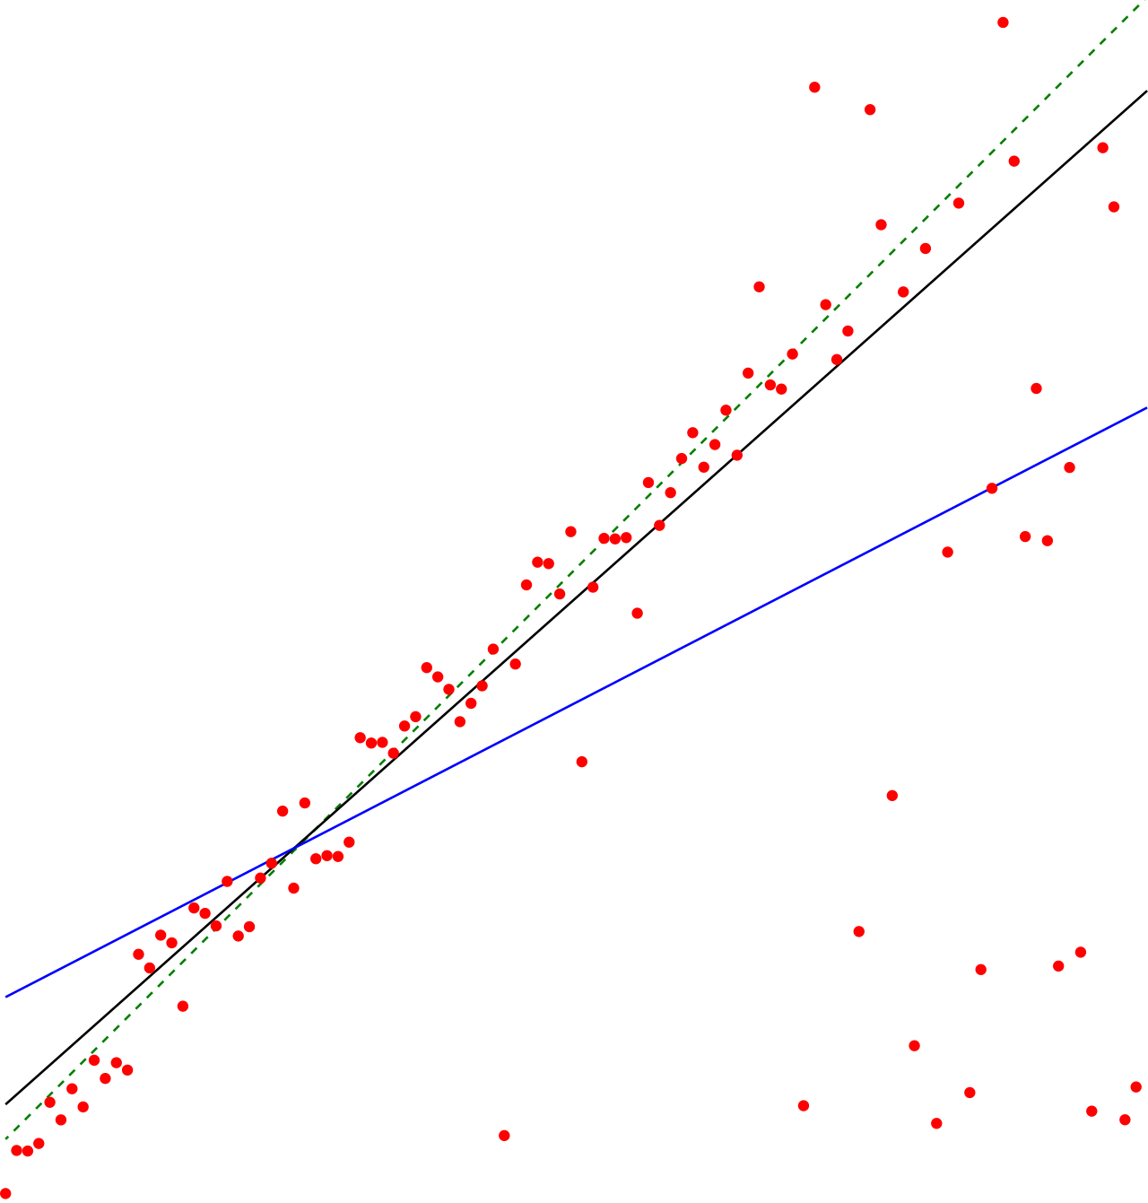
Other prediction methods
Theil–Sen estimator (black)
simple linear regression (blue)

Slide 40
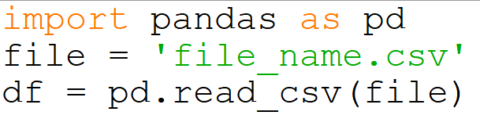
Importing data example

Slide 41
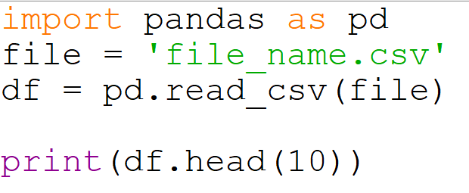
Importing data example

Slide 42
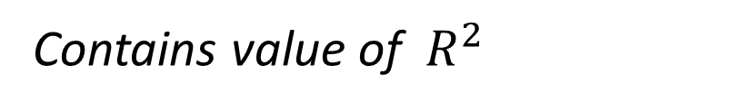
Linear regression – sklearn
sklearn - - - - > linear_model
your_regression = linear_model.LinearRegression()
your_model = your_regression.fit(X, y)
print(your_model.coef_)
print(your_model.score(X,y)
}
dependent variable
training data set
independent variable
creating model of your data set
only if fit_intercept = true is set
Contains slope and intercept
Contains value of $R^{2}$
https://scikit-learn.org/stable/modules/generated/sklearn.linear_model.LinearRegression.html

Slide 43
Linear regression – sklearn
Predictions with ready models:
y_prediction = model.predict(x_pred)
Result can be shown using matplotlib
reshaping might be needed
can be generated via np.linspace method
or
list comprehension

Slide 44
Zbiór danych
https://www.kaggle.com/kumarajarshi/life-expectancy-who
https://www.enjoyalgorithms.com/blog/life-expectancy-prediction-using-linear-regression

Slide 45
Decision trees
Python
Wrocław, 2022

Slide 46
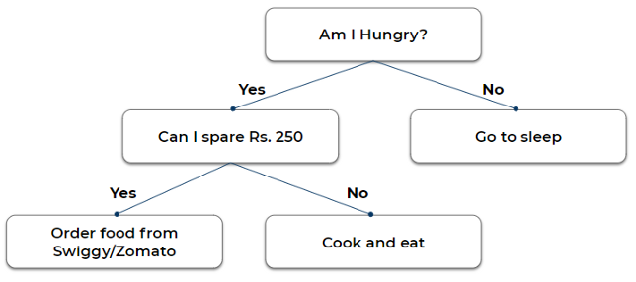

Slide 47
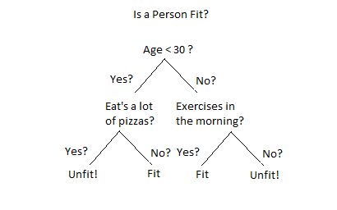

Slide 48


Slide 49
What are decision trees?
A decision tree is a supervised learning technique that has a pre-defined target variable and is most often used in classification problems. This tree can be applied to either categorical or continuous input & output variables. The training process resembles a flow chart, with each internal (non-leaf) node a test of an attribute, each branch is the outcome of that test, and each leaf (terminal) node contains a class label. The uppermost node in the tree is called the root node.

Slide 50
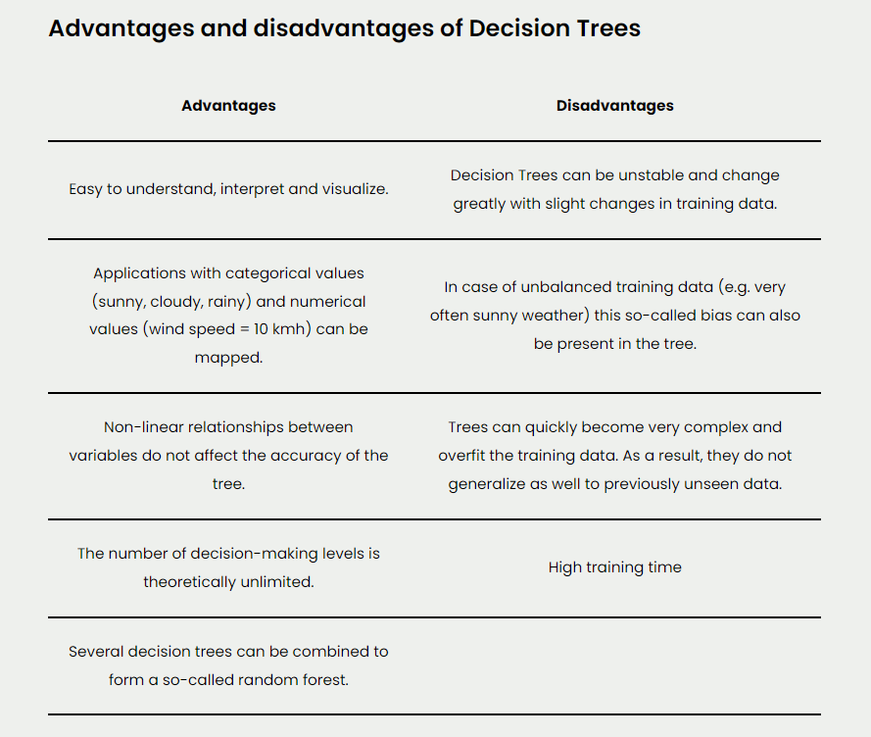

Slide 51
How to build a tree
CART-Classification and Regression Trees
ID3-Iterative Dichotomiser 3
C4.5
CHAID-Chi-squared Automatic Interaction Detection
Main question: which feature should be use first?

Slide 52
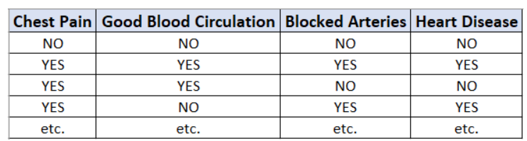
Exemplary problem – prediction of heart disease

Slide 53
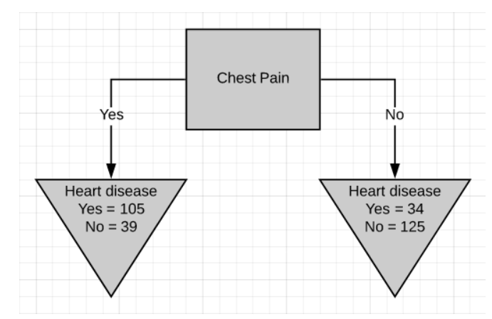
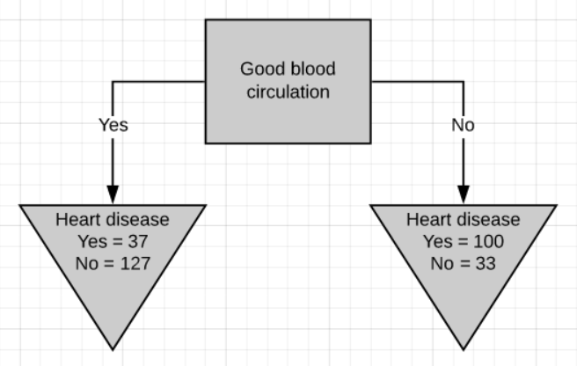
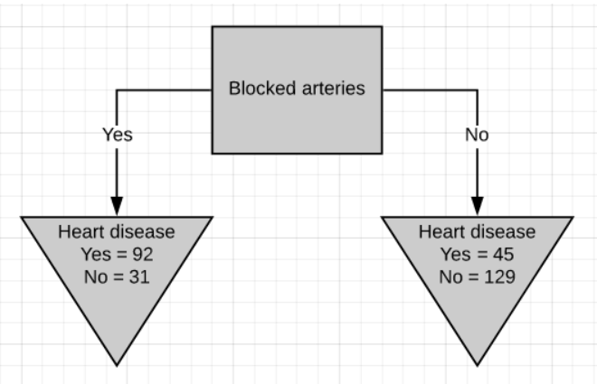
How different features answer to the question

Slide 54
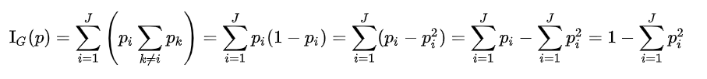
Gini impurity score
Squared probability for each possible answer – in case of binary trees – probability of first and second answer

Slide 55
How different features answer to the question

Slide 56
CART-Classification and Regression Trees
We use Gini impurity score to grade diffent features – this describe how well they answer our main question
We look for the feature with the least impurity
Impurity = 0 means that the feature perfectly split the data

Slide 57
CART-Classification and Regression Trees
We use Gini impurity score to grade diffent features – this describe how well they answer our main question
Impurity = 0 means that the feature perfectly split the data
Steps:
Calculate the Gini impurity scores.
If the node itself has the lowest score, then there is no point in separating the patients anymore and it becomes a leaf node.
If separating the data results in improvement then pick the separation with the lowest impurity value.

Slide 58
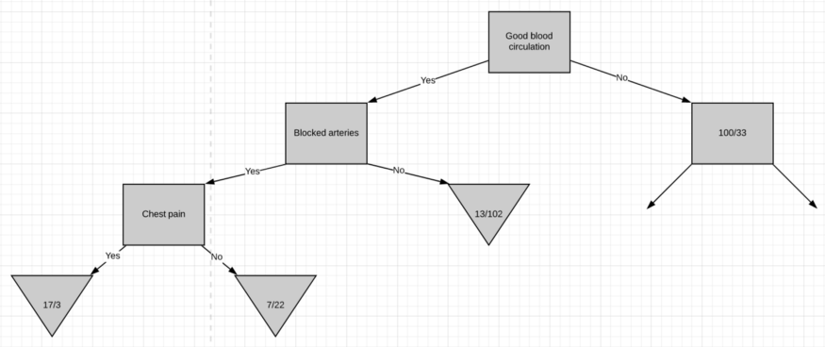

Slide 59
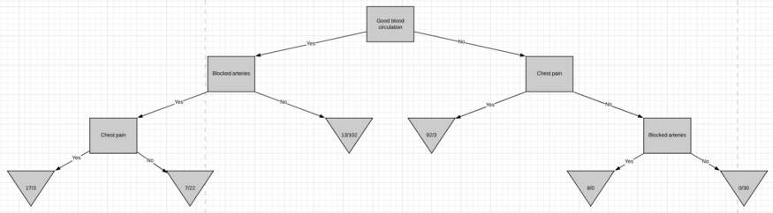

Slide 60
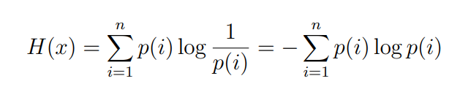
Entropy
In information theory, the entropy of a random variable is the average level of "information", "surprise", or "uncertainty" inherent to the variable's possible outcomes.
Entropy gives a number between 0 and 1, where means pure separation and 1 random separation
Entropy describes impurity of subset rather than impurity of the choice, so we use information gain to grade possible splits.

Slide 61
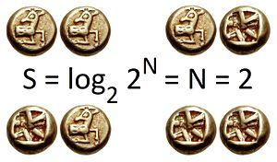
Examples

Slide 62
Examples

Slide 63
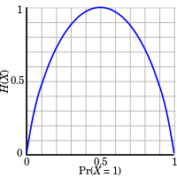
Examples

Slide 64
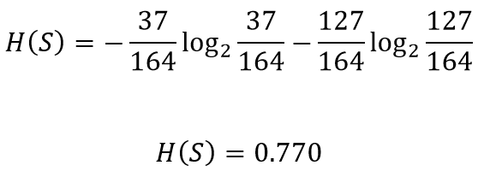
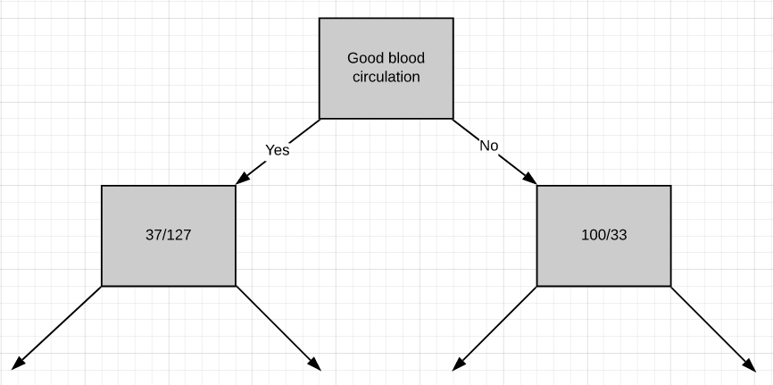

Slide 65
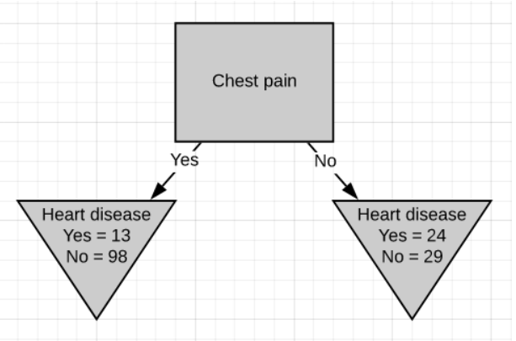
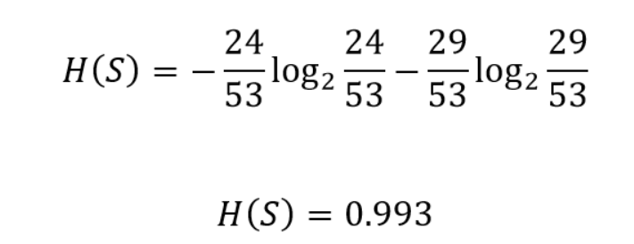
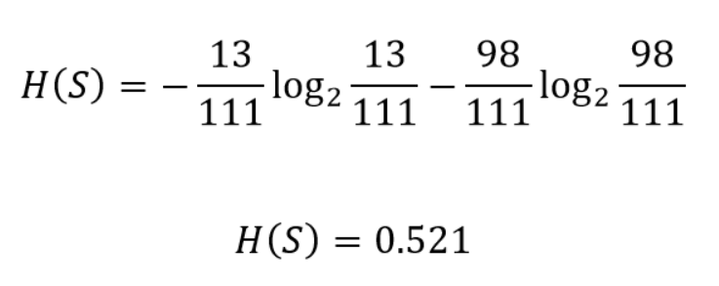

Slide 66
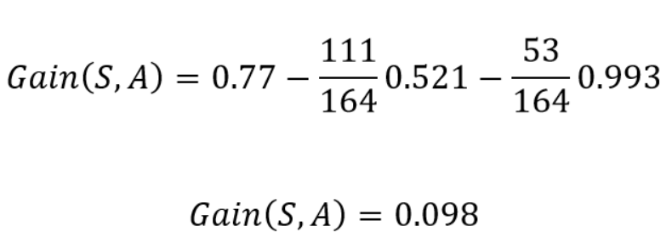
What is a gain in this situation

Slide 67
https://scikit-learn.org/stable/modules/generated/sklearn.tree.DecisionTreeClassifier.html
https://scikit-learn.org/stable/modules/tree.html
https://www.kaggle.com/prashant111/decision-tree-classifier-tutorial

Slide 68
K-means clustering
Python
Wrocław, 2022

Slide 71
Clustering

Slide 72

Centroid

Slide 73

K-means clustering

Slide 74

K-means clustering

Slide 75


Slide 76
How good is clustering? How to choose number of clusters

Slide 77




Slide 78


Elbow method

Slide 79
Elbow method – possible problems

Slide 80

Silhoutte

Slide 81

Silhoutte

Slide 82

Silhoutte

Slide 83
Silhoutte

Slide 84

Other methods…

Slide 85

K-means clustering - problems

Slide 86



Slide 87
Naive (?) Bayes
Python
Wrocław, 2022

Slide 88
Quick question
Runner A won 6 Times on the distance of 400 m in this season, while Runner B won only 2 Times
Who is probable winner of the next run?

Slide 89
Quick question
Runner A won 6 Times on the distance of 400 m in this season (including 1 Time with strong wind), while Runner B won only 2 Times both in the stron wind.
Who is probable winner of the next run if we know that there will be strong wind?

Slide 90


Slide 91


Slide 92


Slide 93


Slide 94

What if we have more than one variable?

Slide 95


Slide 96

Naive Bayes Classifier

Slide 97


Slide 98
Applications of Naive Bayes Algorithms
Real-time Prediction: Being a fast learning algorithm can be used to make predictions in real-time as well.
MultiClass Classification: It can be used for multi-class classification problems also.
Text Classification: As it has shown good results in predicting multi-class classification so it has more success rates compared to all other algorithms. As a result, it is majorly used in sentiment analysis & spam detection.

Slide 99

Confusion matrix

Slide 100



Slide 101


Confusion matrix

Slide 102

Other concept than accuracy

Slide 103
Gaussian vs Bernoulli vs Multinomial
Bernoulli Naive Bayes : It assumes that all our features are binary such that they take only two values. Means 0s can represent “word does not occur in the document” and 1s as "word occurs in the document" .
Multinomial Naive Bayes : Its is used when we have discrete data (e.g. movie ratings ranging 1 and 5 as each rating will have certain frequency to represent). In text learning we have the count of each word to predict the class or label.
Gaussian Naive Bayes : Because of the assumption of the normal distribution, Gaussian Naive Bayes is used in cases when all our features are continuous. For example in Iris dataset features are sepal width, petal width, sepal length, petal length. So its features can have different values in data set as width and length can vary. We can’t represent features in terms of their occurrences. This means data is continuous. Hence we use Gaussian Naive Bayes here.
Akshit Singh

Slide 104



Gaussian vs Bernoulli vs Multinomial
Akshit Singh

Slide 105

Classification

Slide 106


Naive Bayes – text classification

Slide 107

Possible problems

Slide 108

Possible problems

Slide 109
https://github.com/prateeksawhney97/MNIST-Classification-Multinomial-vs-Gaussian-Naive-Bayes/blob/master/MNIST%20Classification.ipynb

Slide 110
Neural networks
Python
Wrocław, 2022

Slide 111


Slide 112


Slide 113


Slide 114

Artificial neuron

Slide 115


Slide 116


Slide 117

History of neural networks

Slide 118


Slide 119
Activation function
An activation function in a neural network defines how the weighted sum of the input is transformed into an output from a node or nodes in a layer of the network.
Sometimes the activation function is called a “transfer function.” If the output range of the activation function is limited, then it may be called a “squashing function.” Many activation functions are nonlinear and may be referred to as the “nonlinearity” in the layer or the network design.

Slide 120


Slide 121

Activation function

Slide 122



Sigmoid activation function

Slide 123



TanH ReLu

Slide 124



Slide 125

Softmax

Slide 126
Loss function
1. Regression Loss Function: Regression models deals with predicting a continuous value for example given floor area, number of rooms, size of rooms, predict the price of the room. The loss function used in the regression problem is called “Regression Loss Function”.
2. Binary Classification Loss Functions: Binary classification is a prediction algorithm where the output can be either one of two items, indicated by 0 or 1. The output of binary classification algorithms is a prediction score (mostly). So the classification happens based on the threshold the value (default value is 0.5). If the prediction score > threshold then 1 else 0.
3. Multi-class Classification Loss Functions: Multi-Class classification are those predictive modeling problems where there are more target variables/class. It is just the extension of binary classification problem

Slide 127




Slide 128


Slide 129


Slide 130

Gradient Descent

Slide 131

Gradient Descent

Slide 132

Gradient Descent

Slide 133

Gradient Descent

Slide 134

Backpropagation
https://home.agh.edu.pl/~vlsi/AI/backp_t_en/backprop.html

Slide 135
Kinds of ANN
https://towardsai.net/p/machine-learning/main-types-of-neural-networks-and-its-applications-tutorial-734480d7ec8e

Slide 136

Why dense neural network can be not sufficient?

Slide 137


Why dense neural network can be not sufficient?

Slide 138
How we can reduce input size?

Slide 139

Negative
For every pixel → pixel = pixel * -1

Slide 140


Slide 141



Slide 142


Slide 143



Stride

Slide 144

„Same” padding

Slide 145

Convolutional neural network (CNN)

Slide 146

Pooling layer

Slide 147

Dropout layer

Slide 148


Metrics
https://keras.io/api/metrics/

